Slide 1


The Broad Context of Psychosocial Risks at Work
Professor Maureen Dollard
Director of Asia Pacific Centre for Work Health & Safety
A World Health Organization Collaborating Centre in Occupational Health
Keynote, Victoria Trades Hall, 2015

Slide 2
Forecast emerging organisational, social and human work related risks
Changing labour markets
Changing work organisations
Impact on work characteristics
Unstable labour markets, precarious contracts
New forms of employment contracting practices
Job insecurity
Globalisation
Lean production, outsourcing
Intensification of work, high work load, work pressure
Van den Bossche, S., Smulders, P., Houtman, I. Trends and risk groups in working conditions, TNO 2006
Long working hours
Changing workforce
Impact on individuals
Poor work life balance
Ageing work force
Older workers

Slide 3
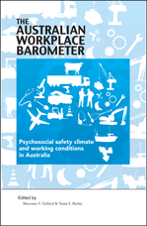
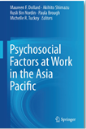
Dollard, M.F. & Bailey, T. S. (Eds)., (2014). Australian Workplace Barometer: Psychosocial Safety Climate and working conditions in Australia, Samford Valley QLD; Australian Academic Press http://tinyurl.com/lunco7l
Dollard, M.F., Shimazu, A., Nordin, R. Bin, Brough, P., Tuckey, M.R. (Eds.), (2014). Psychosocial Factors at Work in the Asia Pacific Dordrecht; Springer International Publishing.
Psychosocial factors at work

Slide 4

Multi-level model of psychosocial factors at work (Dollard, 2013)
Employment Conditions
(Full employment, Precarious employment, Informal employment, Child labour, Slavery & bonded labour)
Psychosocial Work Conditions
(Workload, Work hours, Job control, Job insecurity, Bullying, Violence, Shift work, Work intensification, Repetitive tasks, Inadequate rewards, Injustice, Work-life conflict, Technology interface)
Policies
Labor market policies
(Labor regulations,
Industrial relations)
Welfare state policies
(Social policies)
Globalization
National Political Power Relations
(Unions, Corporations, Government, Political parties, NGOs, Community associations)
National Culture
Corruption
Psychosocial Safety Climate (Policies, practices and procedures for psychological health)
Worker Health
(Distress, Depression, Anxiety, Anger, Suicide, Cardiovascular disease, MSDs, Injuries)
Health Related Behaviors
(Lifestyle, Medication, Workaholism)
Gender, Age
Income Inequality
Social and Family Networks
Health Systems
Fig. 1.3
Dollard, M.F., Shimazu, A., Nordin, R. Bin, Brough, P., Tuckey, M.R (Eds.), (2014). Psychosocial Factors at Work in the Asia Pacific Dordrecht; Springer International Publishing. 978-94-017-8974-5

Slide 5
External
Organisational
Job design
Individual
Layers of influence on worker health

Slide 6
The Cause of the Causes
Extended Health Erosion Path
?
Demands
Psychological
Health
Resources
Engagement
Extended Motivational Path
Job Demands-Resources Model
Demerouti, Bakker et al., 2001

Slide 7
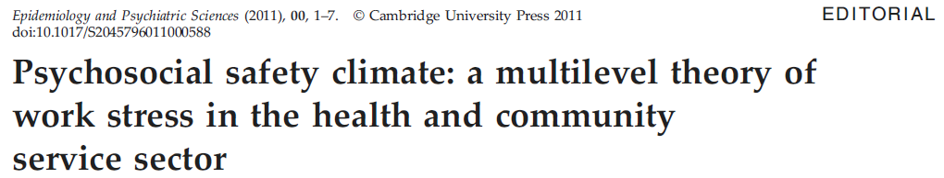
External Factors
Psychosocial safety
climate
Extended Health Erosion Path
Demands
Psychological
Health
Safety Outcomes
Accidents
Injuries
Errors
Quality of Service
Quality of Care
Psychosocial safety
climate
Resources
Engagement
Extended Motivational Path
Primary Prevention Secondary Intervention Tertiary Intervention

Slide 8
PSC Defined
Psychosocial safety climate (PSC) refers to shared perceptions regarding policies, practices, and procedures for the protection of worker psychological health and safety

Slide 9
PSC Ingredients
Management commitment
1. In my workplace senior management acts quickly to correct problems/issues that affect employees’ psychological health
2. Senior management acts decisively when a concern of an employees’ psychological status is raised
3. Senior management show support for stress prevention through involvement and commitment
Priority
4. Psychological well-being of staff is a priority for this organization
5. Senior management clearly considers the psychological health of employees to be of great importance
6. Senior management considers employee psychological health to be as important as productivity
Communication
7. There is good communication here about psychological safety issues which effect me
8. Information about workplace psychological well-being is always brought to my attention by my manager/supervisor
9. My contributions to resolving occupational health and safety concerns in the organization are listened to
Participation and involvement
10. Participation and consultation in psychological health and safety occurs with employees’, unions and health and safety representatives in my workplace
11. Employees are encouraged to become involved in psychological safety and health matters
12. In my organization, the prevention of stress involves all levels of the organization

Slide 10
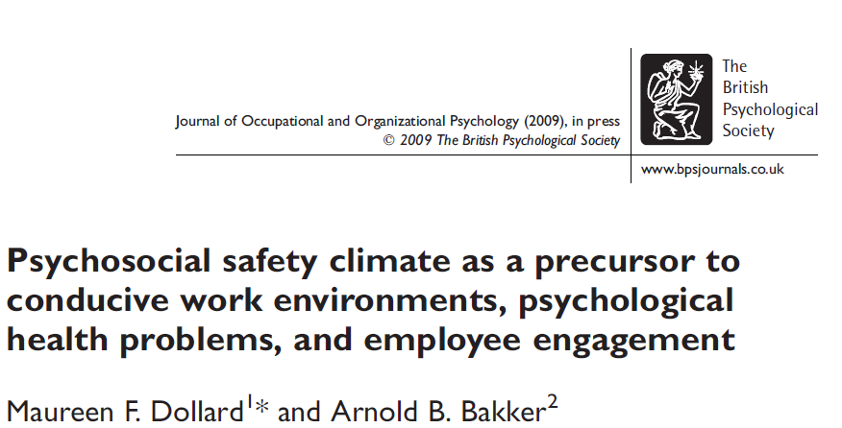
the Evidence
Work Pressure
Emotional Demands
Psych Distress
Emotional Exhaustion
School PSC
Learning Possibility
Decision Influence
Engagement
Controls for Time 1 Dependent measures
N = 262 Time1; N = 196, Time 2
18 schools

Slide 11
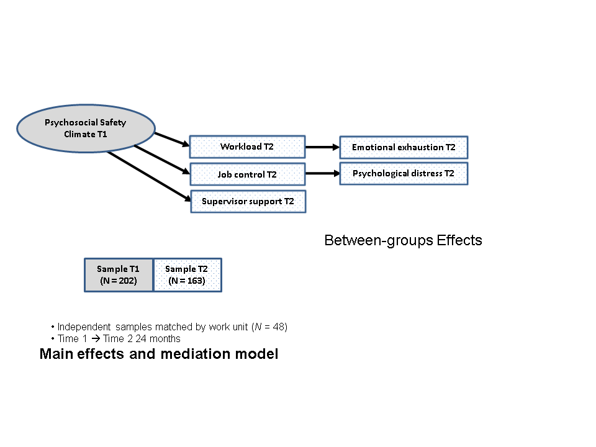
Psychosocial Safety Climate T1
Workload T2
Emotional exhaustion T2
Job control T2
Psychological distress T2
Supervisor support T2
Between-groups Effects
Sample T1
(N = 202)
Sample T2
(N = 163)
Independent samples matched by work unit (N = 48)
Time 1 → Time 2 24 months
Main effects and mediation model

Slide 12
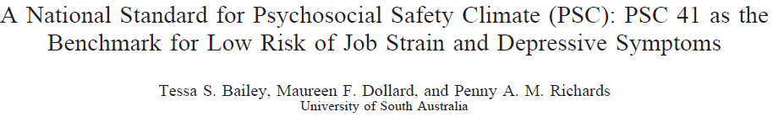
PSC Standards
PSC range 12 – 60
Low risk PSC 41 or above
Medium risk PSC 38-40
High risk PSC 37 or below (35% of respondents)

Slide 13
Using PSC to estimate productivity loss(Becher & Dollard)
A Pro-Social Approach to Productivity using the Australian Workplace Barometer
Cost of low PSC via sickness absence:
AUD 2.4 billion p.a.
Cost of low PSC via presenteeism:
AUD 3.6 billion p.a.
Total cost of low PSC to employers:
AUD 6 billion p.a.
Workers PSC | Annual sickness absence (hours) | Cost via sickness absence | Productivity Loss | Cost via presenteeism
Low | 60.3 | $2,109 | 5.5% | $3,113
Moderate | 59.1 | $2,067 | 5.4% | $3,042
High | 42.3 | $1,479 | 3.2% | $1,856
Notes:
Calculated using logistic binominal regression models with robust variance to produce adjusted relative risk ratios, which were used to calculate population attributable risk upon sickness absence and presenteeism.
Sickness absence based on sick days in the past 4 weeks extrapolated to an entire years salary. Presenteeism costs based on performance below the average healthy worker (8.36/10) applied against average salary.

Slide 14
Leadership for Psychosocial safety climate
Using the ESENER data 28 000 establishments > 10 employees—most senior OSH managers. Questions were:
“Does your establishment have a procedure to deal with,
work-related stress;
bullying or harassment;
work-related violence?”;
“What about the role of employees: Have they been consulted regarding measures to deal with psychosocial risks?” and
“Are employees encouraged to participate actively in the implementation and evaluation of the measures?”
Alpha was .87.

Slide 15
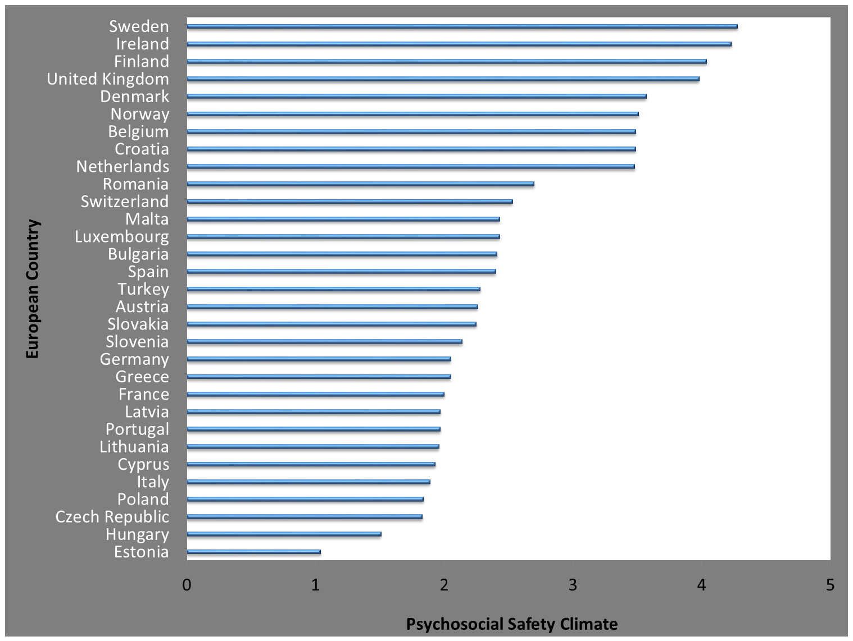
23 per cent of variance in PSC
is due to country
Psychosocial Safety Climate Leadership

Slide 16
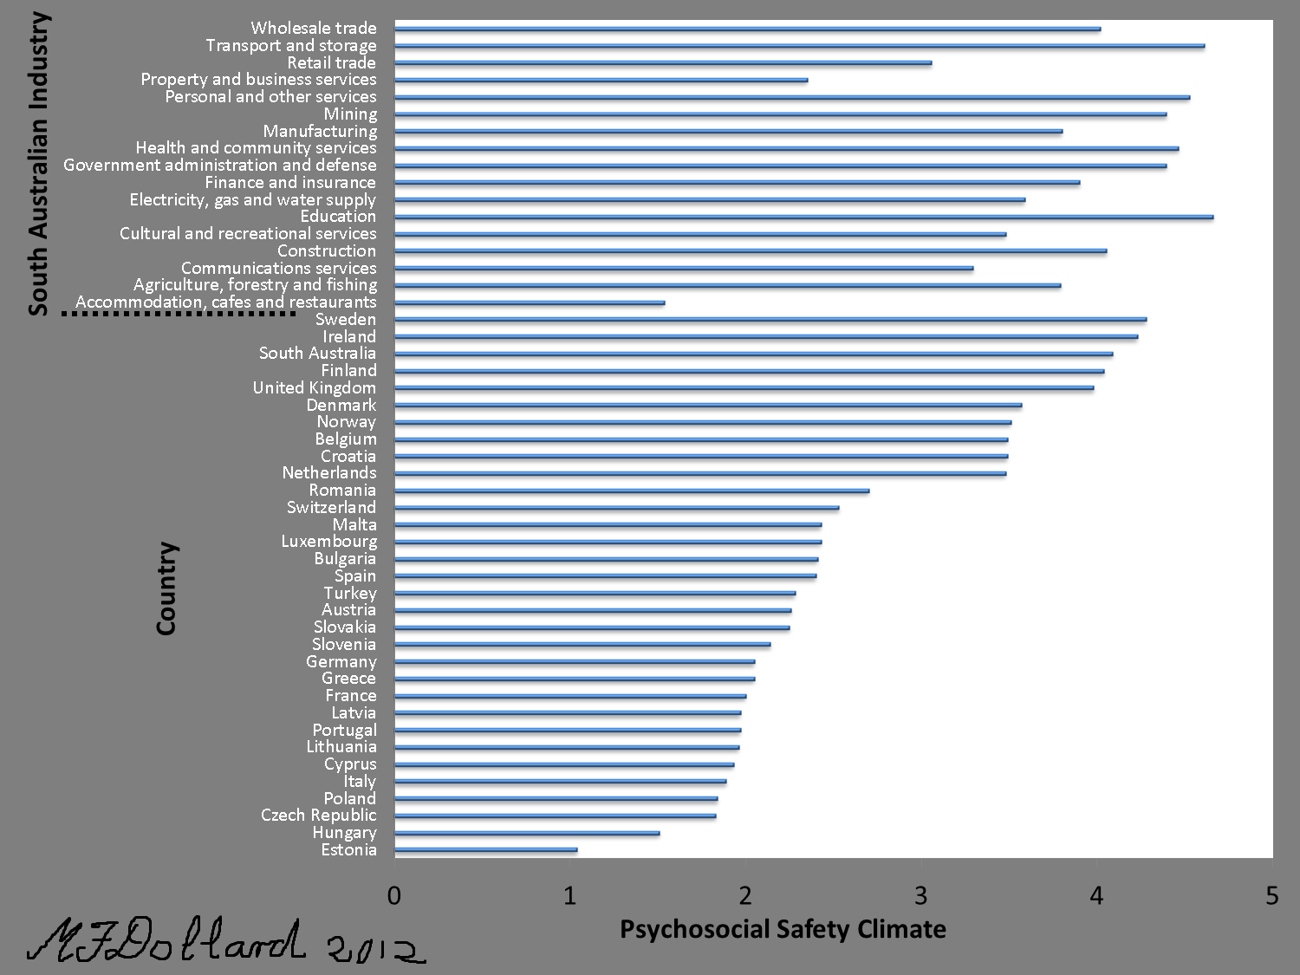

Slide 17
Europe (European Working Conditions Survey 2010)
q71b. Over the past 12 months, during the course of your work have you been subjected to bullying /harassment?
N = 41, 034, Employed only
Australia (AWB 2009-2014/2015)
Bullying is a problem at some work-places and for some workers. To label something, as bullying, the offensive behaviour has to occur repeatedly over a period of time, and the person confronted has to experience difficulties defending him or herself. The behaviour is not bullying if two parties of approximate equal “strength” are in conflict or the incident is an isolated event.
Have you been subjected to bullying at the workplace during the last six months?
N = 5919, Employed only 2009-2011
N = 4242, Employed only 2014/2015

Slide 18
Published Papers on PSC
Books/ Book Chapters
Dollard, M.F., Shimazu, A., Nordin, R. Bin, Brough, P., Tuckey, M.R (Eds.), (2014). Psychosocial Factors at Work in the Asia Pacific. Dordrecht; Springer International Publishing. 978-94-017-8974-5
Dollard, M.F. & Bailey, T. S. (Eds)., (2014). Australian Workplace Barometer: Psychosocial Safety Climate and working conditions in Australia, Samford Valley QLD; Australian Academic Press
Bailey, T., Pignata, S., & Dollard, M.F. (2014). 'Psychosocial interventions and worker wellbeing'. In Ronald J. Burke and Astrid M. Richardsen, Corporate wellness programs: Linking individual and organizational health
Edward Elgar Publishing Ltd
Pignata, S., Biron, C., Dollard, M.F. (2014). Managing psychosocial risks in the workplace prevention and intervention, In Peeters, M. et al (Eds). An introduction to contemporary work psychology, 393-413.
Dollard, M.F. (2011). Psychosocial safety climate: A lead indicator of work conditions, workplace psychological health and engagement and precursor to intervention success. In Managing psychosocial risks in the workplace: The role of process issues. In Eds C. Biron, M. Karanika-Murray, & C. L. Cooper, Publisher: Routledge/Psychology Press.
Dollard, M.F., & Karasek, R. (2010). Building psychosocial safety climate: Evaluation of a socially coordinated PAR risk management stress prevention study. In J. Houdmont, & S. Leka (Eds). Contemporary occupational health psychology: Global perspectives on research and practice, (pp. 208-234). Chichester: Wiley Blackwell.
Brooks, B., Staniford, A., Dollard, M.F., & Wiseman, R.J. (2010). Risk factors. Consequences, and management of aggression in health care environments. In J. Houdmont, & S. Leka (Eds). Contemporary occupational health psychology: Global perspectives on research and practice, (pp. 229-254). Chichester: Wiley Blackwell.
Refereed Journal Articles
Bailey, Tessa S.; Dollard, Maureen F.; Richards, Penny A. M. A national standard for psychosocial safety climate (PSC): PSC 41 as the benchmark for low risk of job strain and depressive symptoms. Journal of Occupational Health Psychology, Vol 20(1), Jan 2015, 15-26.
Idris, M. A., Dollard, M. F., & Tuckey, M. R. (2015, March 16). Psychosocial Safety Climate as a Management Tool for Employee Engagement and Performance: A Multilevel Analysis.
International Journal of Stress Management. Advance online publication.
Kwan, S. S. M., Tuckey, M. R., & Dollard, M. F. (in press, accepted 26 Oct 2014). The role of psychosocial safety climate in coping with workplace bullying: A grounded theory and sequential tree analysis. European Journal of Work and Organizational Psychology.
Bailey, T. S., Dollard, M. F., McLinton, S. S., & Richards, P. A. M. (2015). Psychosocial safety climate and physical factors in the etiology of MSDs and workplace physical injury compensation claims. Work & Stress.
McLinton, S. S., Dollard, M. F., Tuckey, M., & Bailey, T. S. (2014). The prevalence and nature of bullying: A national study of Australian workers. Journal of Health, Safety and Environment, 30, 283-300.
Idris, A., Dollard, M. F. & Yulita (2014). Psychosocial safety climate, emotional demands, burnout and depression: A longitudinal multilevel study in the Malaysian private sector, Journal of Occupational Health Psychology, 19, 291-302.
Dollard, M. F., Gordon, J. A., (2014). Evaluation of a participatory risk management work stress intervention. International Journal of Stress Management, 21, 27-42.
Brough, P., Dollard, M. F., Tuckey, M. R. (2014). Theory and methods to prevent and manage occupational stress: Innovations from around the globe. International Journal of Stress Management, 21, 1-6.

Slide 19
Contd
Dollard, M. F., Neser, D.Y. (2013). Worker health is good for the economy: Union density and psychosocial safety climate as determinants of country differences in worker health and productivity in 31 European countries. Social Science and Medicine, 92, 114-123.
Opie, T., Dollard, M. F., Lenthall, S., Knight, S. (2013). Occupational stress in remote area nursing: Development of the remote area nursing stress scale (RANSS). Journal of Nursing Measurement, 21, 246-263.
McTernan, W. P., Dollard, M. F., & LaMontagne, A. D. (2013). Depression in the workplace: An economic cost analysis of depression-related productivity loss attributable to job strain and bullying. Work & Stress, 27, 321-338.
Dollard, M. F., Osborne, K., & Manning, I. (2013). A macro-level shift in modelling work distress and morale. Journal of Organizational Behavior, 34, 629–647.
Tuckey, M. R., Chrisopoulos, S. & Dollard, M. F. (2012). Job demands, resource deficiencies, and workplace harassment: Evidence for micro-level effects. International Journal of Stress Management, 19, 292-310.
Dollard, M. F., Tuckey, M. R., & Dormann, C. (2012). Psychosocial safety climate moderates the job demand-resource interaction in predicting workgroup distress. Accident Analysis and Prevention, 45, 694-704.
Dollard, M. F., Osborne, K., & Manning, I. (2013). A macro-level shift in modelling work distress and morale, Journal of Organizational Behavior, 34, 629–647.
Rickard, G., Lenthall, S., Dollard, M., Opie, T., Knight, S., Dunn, S., Wakerman, J., Macleod, M., Seiler, J. & Brewster-Webb, D. (2012). Organisational intervention to reduce occupational stress and turnover in hospital nurses in the Northern Territory, Australia. Collegian, 19, 211-221
Dollard, M.F., & McTernan, W. (2011). Psychosocial safety climate a multilevel theory of work stress in the health and community sector, Epidemiology and Psychiatric Services, 1-7, Cambridge University Press. (Editorial)
Law, R., Dollard, M.F., Tuckey, M.R., & Dormann, C. (2011). Psychosocial safety climate as a lead indicator of workplace bullying and harassment, job resources, psychological health and employee engagement, Accident Analysis and Prevention, 43, 1782-1793.
Idris, M.A., Dollard, M.F., Coward, J., & Dormann, C. (2011, in press). Psychosocial safety climate: Conceptual distinctiveness and effect on job demands and worker psychological well-being. Safety Science.
Idris, M.A & Dollard, M.F. (2011). Psychosocial safety climate, work conditions, and emotions in the workplace: A Malaysian population-based work stress study. International Journal of Stress Management.
Idris, M.A, Dollard, M.F & Winefield, A.H. (2011). Integrating psychosocial safety climate in the JD-R model: A study amongst Malaysian workers. South African Journal of Industrial Psychology. Vol 37. 1-11.
Tuckey, M.R., Winwood, P., Dollard, M.F. (2011) Psychosocial culture and pathways to psychological injury within policing. Police Practice and Research, 1-17. Review
Bond, S. A., Tuckey, M. R., Dollard, M. F., (2010). Psychosocial safety climate, workplace bullying, and symptoms of posttraumatic stress. Organization Development Journal, 28, 37- 56.
Hall, G.B., Dollard, M.F., & Coward, J. (2010). Psychosocial Safety Climate: Development of the PSC-12. International Journal of Stress Management, 4, 353-383.
Dollard, M.F., & Bakker, A. B. 2010. Psychosocial safety climate as a precursor to conducive work environments, psychological health problems, and employee engagement. Journal of Occupational and Organizational Psychology, 83, 579-599.

