Slide 2
Leading Indicators in Occupational Health and Safety
Professor Helen De Cieri
Monash Business School
Monash University
© Monash University 2015

Slide 3
How well are ‘leading indicators’ of OHS managed and measured in your workplace?
Measures of the positive steps that organisations take to prevent an OHS incident
Resources that are available in the workplace and that impact OHS performance
OHS Performance
OHS leading indicators

Slide 4
What are OHS Leading Indicators?
“OHS Incidents are often not reported.”
“Management at my workplace does not consider OHS a priority.”
Management commitment to OHS
Regular OHS inspections & audits
OHS systems (policies, procedures, practices)
Prioritisation of OHS
Risk management
Consultation and communication about OHS
OHS accountability
Positive feedback and recognition for OHS
OHS empowerment & employee involvement in decision making
OHS training, information, resources and equipment
“OHS doesn’t seem to be a high priority.”
“Health and safety is talked about but nothing ever gets done.”

Slide 5
Why measure OHS leading indicators?
Practical actions to improve OHS
Work practices that prevent OHS incidents
OHS leadership
Resources for health and safety
Shift the focus to:
Shift the focus to:
Alongside other metrics
To identify areas for OHS improvement
To identify groups at risk
To compare and benchmark
To inform decisions and actions
Measure leading indicators in your workplace:
5

Slide 6
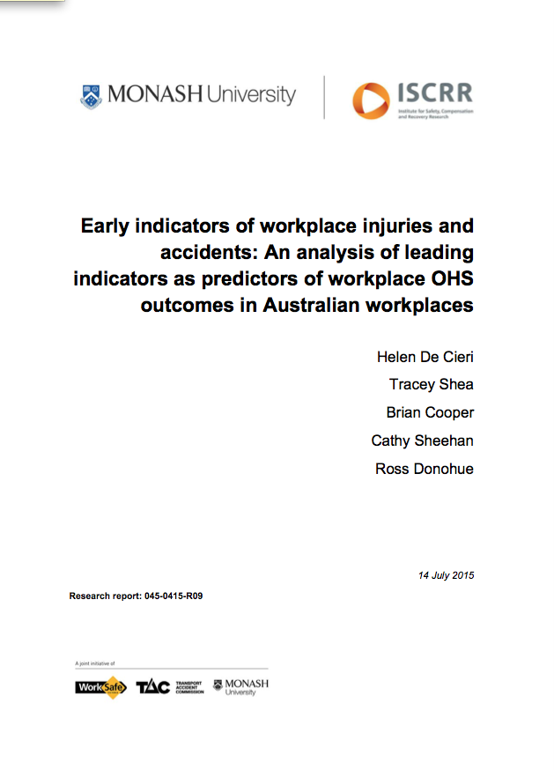
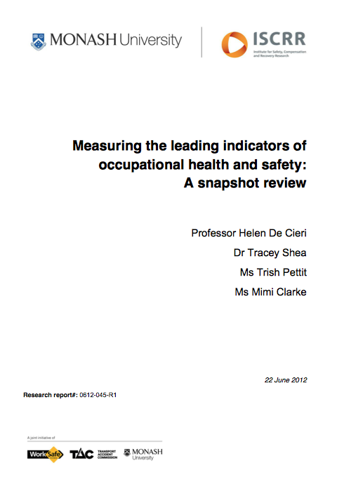
Research: To find a simple measure of leading indicators
The “Organizational Performance Metric” (OPM), developed at the Institute for Work and Health, Ontario Canada, is a simple and practical tool to measure leading indicators.
For information about the original OPM, see www.iwh.on.ca
We have adapted and tested the OPM for use in Australian workplaces:
the Australian OPM (A-OPM)
In total, we have tested the A-OPM with over 13,000 people.
For information about the Australian OPM and to read our research reports, see: www.ohsleadindicators.org
or www.iscrr.com.au

Slide 7
The Australian Organizational Performance Metric (A-OPM)
The Australian OPM is a set of 8 items asking you to respond to a set of statements about health and safety in your workplace.
Your responses to the 8 items are summed to reach a total A-OPM score from 8 to 40.
A higher score on the A-OPM means that you agree that OHS leading indicators are present in your workplace
Individual responses can be grouped to reach an average score e.g., the average score for a workplace.

Slide 8
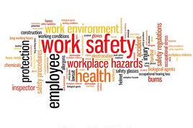
Workplace Surveys 2013-2015: What did we ask?
We conducted questionnaires surveys in workplaces around Australia to test the A-OPM.
To validate the A-OPM, we asked other questions too
Survey includes A-OPM, safety climate, OHS leadership, OHS-related attitudes and behaviours, self-reported OHS outcomes
Responses compared against workplace-level OHS outcomes (lagging indicators, e.g., injury rates) for the three months following the survey.

Slide 9
Workplace Surveys 2013-15: Who answered our surveys?
Six industries: Arts & Recreation; Healthcare; Construction; Mining; Transport Postal & Warehousing; Electricity, Gas, Water, & Waste
Six employers
66 workplaces
3,605 responses (35% response rate)
170 managers; 694 supervisors; 2741 workers
Men = 61%
1%
10%
19%
1%
13%
56%

Slide 10
A-OPM Comparison across Industries
A-OPM scores can range from 8 to 40
A higher score reflects that the respondent agrees that OHS leading indicators are present in his/her workplace
Differences can be seen across industries

Slide 11
A-OPM Comparison across Employment Level
Managers are more likely to agree that OHS leading indicators are present.

Slide 12
A-OPM Comparison across Six Organisations
Differences can be seen across organisations
(Multi-industry)
(Arts&Rec)
(Mining)
(Arts&Rec)
(Transport)
(Healthcare)

Slide 13
A-OPM Comparison across Organisation B’s Workplaces
Average score on the A-OPM in
Org B = 26.7
Workplaces with lower A-OPM scores:
Casual workforce
Host/client worksites

Slide 14
Key Results:
A-OPM scores vary across industry, employer, type of job, workplace and employment status.
Three months after the survey, we asked OHS managers to tell us their average OHS incidents and frequency rates at the workplace level (n = 66 workplaces).
Higher scores on the A-OPM at work-place level were associated with a lower:
lost-time injury frequency rate; and
medical-treatment injury frequency rate
Attention to leading indicators is linked to prevention of injuries and illness
OHS Performance (lagging indicators)
OHS leading indicators

Slide 15
Does OHS Leadership Make a Difference?
We asked managers and supervisors to report their OHS Leadership
Manager’s perceptions of own capacity
for OHS leadership, e.g., prioritisation of safety.
OHS leadership is negatively associated with reported incidents and lost time injury frequency rate at the workplace level.
Active transactional leadership has stronger relationships with OHS outcomes than does transformational leadership.
…but both are important!

Slide 16
What else can you do to keep your workplace safe and healthy?
What leads to the ‘best’ OHS performance?
High level of attention to leading indicators AND employees’
safety compliance
behaviour.
What leads to the ‘worst’ OHS performance?
Low level of attention to leading indicators AND
high work overload.

Slide 17
We conducted on-line surveys with members in two unions
Australian Nursing and Midwifery Federation (ANMF – VIC Branch)
4,891 ANMF members (7% response rate)
67% registered nurses
93% women
Australian Education Union (AEU - Vic Branch)
4,750 AEU members (10% response rate)
75% worked in a primary or secondary school
77% women

Slide 18
Comparison of A-OPM scores in two union surveys*: ANMF (Vic) and AEU (Vic)
Average A-OPM = 27.2 (SD =6.7) for AEU (Vic) respondents
(n = 4750)
Average OPM = 27.4 (SD = 6.7)
for ANMF (Vic) respondents
(n = 4891)
Respondents who rated their workplaces higher on the A-OPM (leading indicators) were involved in fewer self-reported OHS incidents overall.

Slide 19
ANMF survey: OHS leading indicators are linked to other positive workplace factors
Respondents with higher burnout, emotional labour, work overload, and physical demands, were more likely to have OHS incidents.
Respondents with greater workplace psychological safety (belief that people in this workplace are able to raise tough issues) were less likely to have OHS incidents.

Slide 20
Practical outcomes:
Shift the focus from lagging indicators to managing leading indicators
Compare groups,
Identify areas for improvement
Use the A-OPM to collect views about OHS

Slide 21
How to use the Australian OPM
Information about using this tool: surveys@monash.edu or www.ohsleadindicators.org
The A-OPM could be most useful as part of a suite of tools and indicators that could be applied to give a full picture of workplace health and safety.
Could we include it in a larger survey of the workforce, e.g. regular employee survey?
Do we have the resources available to use and analyse the results of a survey?
Add up the item responses for a score out of 40
Statistical analysis, e.g. average group scores, correlations with other measures
Compare across groups
How can we encourage employees to respond to a survey so that we have a representative sample?

Slide 22
Thank you!
For more information:
contact the researchers at: surveys@monash.edu
Visit www.ohsleadindicators.org
WE ACKNOWLEDGE THE SUPPORT OF KEY STAKEHOLDERS IN THE RESEARCH
Monash University
WorkSafe Victoria
ISCRR
Safe Work Australia
safesearch Executive GM Safety Forum
Employers
Employees
Australian Nursing and Midwifery Federation (Victorian Branch)
Australian Education Union (Victorian Branch)
Institute for Work and Health, Canada

