Slide 1

Workplace bullying: Risk management challenges
Worksafe Victoria and VTHC HSR Conference: Current concerns in OHS October 27, 2015
Dr Carlo Caponecchia
The University of New South Wales
Contact: carloc@unsw.edu.au
@psycarlogy

Slide 2
Outline & scope
Criteria
Behavioural patterns affect recognition and reporting
Barriers to prevention and management
Ways forward for risk management

Slide 3
Is it bullying?
Definitional criteria
Need to use definitional criteria consistently
  repeated (Victoria: persistent, repeated)
  unreasonable (Victoria: negative)
  create risk to health and safety
Check the National guide for examples of behaviours that are and are not considered to be bullying (if they meet the criteria)
Safe Work Australia 2013
Notes:
Even though national guide does not apply in Victoria, it is still useful to help organise information for reports.

Slide 4
Examples of behaviours (SWA, 2013)
Examples of behaviour, whether intentional or unintentional, that may be considered to be workplace bullying if they are repeated, unreasonable and create a risk to health and safety include but are not limited to:
abusive, insulting or offensive language or comments
unjustified criticism or complaints
deliberately excluding someone from workplace activities
withholding information that is vital for effective work performance
setting unreasonable timelines or constantly changing deadlines
setting tasks that are unreasonably below or beyond a person’s skill level
denying access to information, supervision, consultation or resources to the detriment of the worker
spreading misinformation or malicious rumours
changing work arrangements such as rosters and leave to deliberately inconvenience a particular worker or workers.
A single incident of unreasonable behaviour is not considered to be workplace bullying, however it may have the potential to escalate and should not be ignored.
If workplace bullying behaviour involves violence, for example physical assault or the threat of physical assault, it should be reported to the police.

Slide 5
Using the criteria
Repetition
  Arguably the least confusing criterion; same behaviour repeated or different behaviours once in a pattern;
  Behaviours happening to groups can be tricky: can it be dealt with otherwise?
  “Persistent”?
Unreasonableness
  Relevant examples are needed to show what is reasonable “around here”, or not
  Assess through comparison with how others are treated; with what policy/practice states; or what informal regular practice suggests.
  Look to industry “standards” or other similar operations
Notes:
Note Vic guide says monitoring includes having established standards or behaviour

Slide 6
Create risk to health and safety
  Usually for individuals thinking about reporting this means assessing what outcomes have occurred rather than assessing risk per se (likelihood and consequences)
  May not be a 1-to-1 relationship between each behaviour and each outcome
  Eg. “Being ignored” by itself may not have lead to nausea, but together with being publically criticised and excluded from the workgroup’s social events, may have led to such an outcome.

Slide 7
It may not be bullying…
But it could be something else:
Harassment, discrimination, violence
Conflict (un-escalated)
Early stages of a developing issue
An industrial issue
An issue that could be dealt with in another way?
Or it could be nothing of concern
People need assistance with assessing criteria (HRSCEE 2012)
Emphasis on objectivity, seeking advice to achieve more accurate identification before reporting
Notes:
People have to be encouraged not to use the label “bullying” inappropriately.
Don’t squeeze things into bullying criteria.
Bad for you, bad for everyone else.

Slide 8
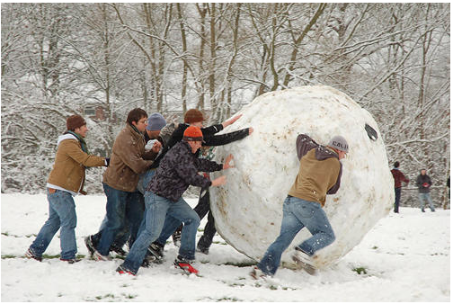
Behaviours
The various behaviours and behavioural patterns/combinations can make identification difficult for individuals and organisations
Mixture of related issues
Straw
Snowball
Importance of
  Timelines
  context (Caponecchia & Wyatt, 2011)

Slide 9
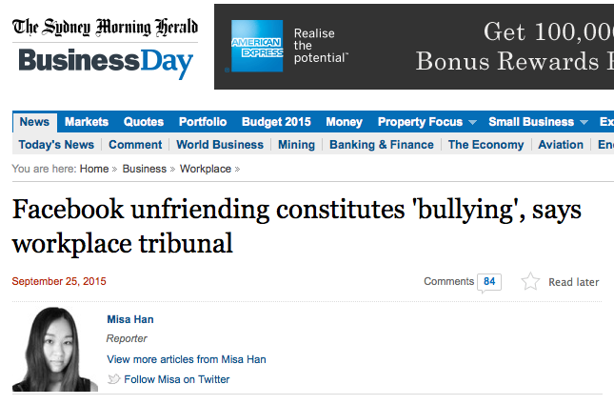
Willett v State of Victoria [2013] VSCA 76 http://www.austlii.edu.au/cgi-bin/sinodisp/au/cases/vic/VSCA/2013/76.html?stem=0&synonyms=0&query=Willett%20police%20victoria
Swan v Monash Law Book Cooperative [2013] VSC 326
http://www.austlii.edu.au/cgi-bin/sinodisp/au/cases/vic/VSC/2013/326.html?stem=0&synonyms=0&query=Wendy%20Swan

Slide 10
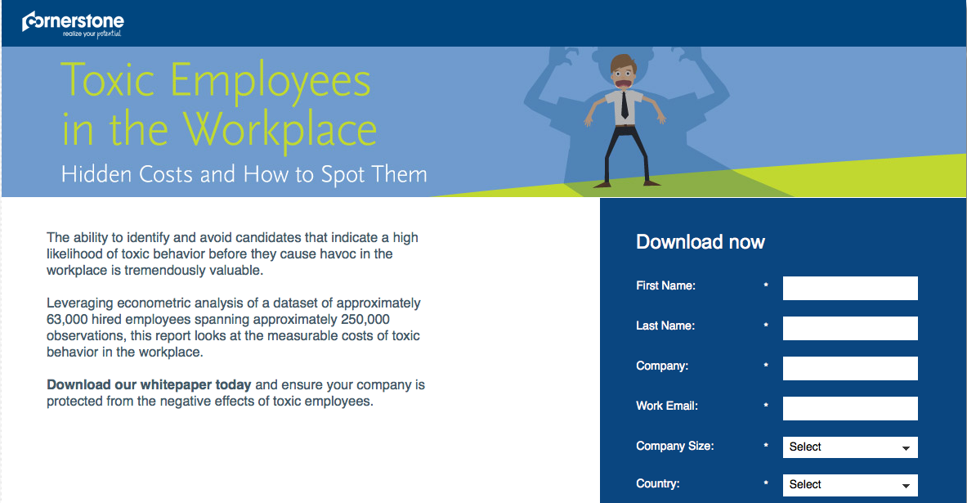
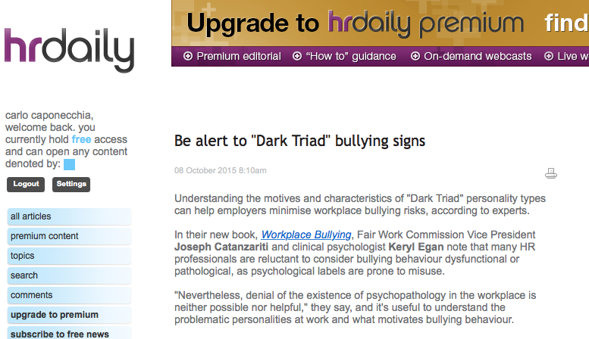
Barriers to recognition & prevention
Fragmented, inconsistent, contradictory approaches
Poorly conceived, poorly implemented ‘controls’ (eg. In policy; reporting systems; zero tolerance rhetoric; Mickey Mouse training…)
Individual-level focus – non WHS/risk
Getting stuck on “Who’s responsible?”
  wider views of mental health
  vulnerability & egg-shell psyche (see Ikpeme Ruths, Christiansen & Vincent, 2012; Iezzi, Duckworth & Schenke, 2013; State of NSW v Rattenbury [2015] NSWWCCPD 46)
  Tendency to overlook the contributions of work, job and organisational design (see Superfriend Promoting Positive Mental Health in the Workplace: A guide for organisations http://www.superfriend.com.au/uploads/page/533/Promoting-Positive-Mental-Health-in-the-Workplace-Guidelines-for-organisations.pdf)

Slide 11
Where we should be…
Focusing on safe systems of work – job and org design
Tailoring existing risk management practices to psychosocial issues (not treated as just HR issues)
  Manage ongoing risks that arise throughout the process of dealing with the problem (eg. Through an investigation)
Thinking about skill sets, frameworks and assumptions:
  Conceptual understanding of WHS frameworks + knowledge and skills wrt psychosocial issues.
  Skill development and assessed competencies for senior staff
Evaluating and prioritising interventions (Branch, Murray & Caponecchia, 2015)

Slide 12
References
Caponecchia, C., Sun, A. Y. Z., Wyatt, A. (2012). ‘Psychopaths’ at Work? Implications of Lay Persons’ Use of Labels and Behavioural Criteria for Psychopathy. J Bus Eth.107, 399-408.
Caponecchia, C., & Wyatt, A. (2011). Preventing workplace bullying: An evidence based guide for managers and employees. Sydney: Allen & Unwin.
House of Representatives Standing Committee on Education and Employment (HRSCEE) (2012). Workplace bullying: We just want it to stop. Canberra: Commonwealth of Australia.
Iezzi, T., Duckworth, M.P. & Schenke, S.R. (2013). To crack or crumble: Use of the Thin Skull and crumbling skull rules. Psychological Injury and Law, 6, 156-159.
Ikpeme Ruths, I.J., Christiansen, A. K. & Vincent, J. P. (2012). An assessment of the “eggshell psyche” in simulated civil litigation. Psychological Injury and Law, 6, 144-155.
Safe Work Australia (2013). Guide for preventing and responding to workplace bullying. Canberra: Safe Work Australia.
Willett v State of Victoria [2013] VSCA 76 http://www.austlii.edu.au/cgi-bin/sinodisp/au/cases/vic/VSCA/2013/76.html?stem=0&synonyms=0&query=Willett%20police%20victoria
Swan v Monash Law Book Cooperative [2013] VSC 326
http://www.austlii.edu.au/cgi-bin/sinodisp/au/cases/vic/VSC/2013/326.html?stem=0&synonyms=0&query=Wendy%20Swan
State of NSW v Rattenbury [2015] NSWWCCPD 46 http://www.austlii.edu.au/au/cases/nsw/NSWWCCPD/2015/46.html

